Slide 1

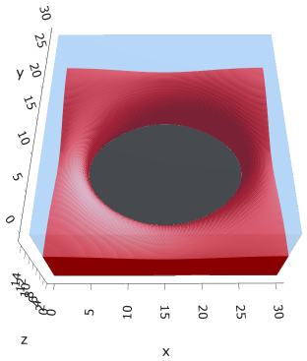
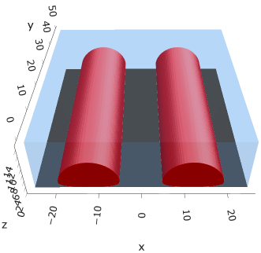
a00s3e3
F = -1.77861

Slide 2









a00s5e3
F = -2.98574
F = -2.98732
F = -2.986
F = -2.98580
F = -2.98637
F = -2.98644

Slide 3
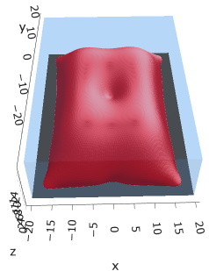


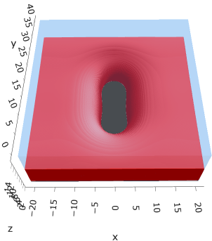

a10
F = -2.93788
F = -2.93788
s005

Slide 4
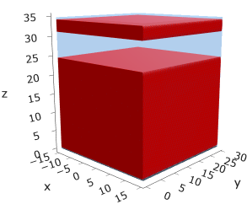
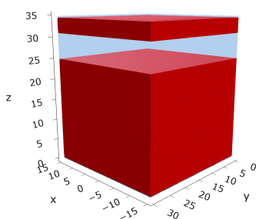
a25
s15
s18

Slide 5




a35
s10
s12
s15
s18

Slide 6



Parallelization
$$α=0, χ=1.25, N=50, σ=0.02$$
$$α=0, χ=1.25, N=200, σ=0.005$$
$$L_{x}=L_{y}=23, { L}_{z}=15$$
Nth = 12: 500 it, 4.3 hrs
Nth = 8 : 500 it, 6.9 hrs
Nth = 6 : 415 it, 20 hrs (poss. mem bottleneck)

Slide 7







Exercise: Micelle / Stripe
s = 5e-03, N = 50, a = 0.0, x = 1.0
s = 5e-03, N = 75, a = 0.0, x = 1.0
Isosurface at pha = 0.1

Slide 8






a040x170s020

Slide 9






a040x170s010

Slide 10

a040x170s025

Slide 11














a040x170s022

Slide 12










a040x170 seed
See if becomes hex
cyl4-975
cyl4-12
cyl16-975
cyl16-1025
cyl1

Slide 13






a040x170s017

Slide 14












































a040x170s015 seed
Almost done
Almost done

Slide 15

















a040x170s013

Slide 16
















a040x170s010 seed

Slide 17














X200 x170 x130 x120 x100
F = −10.24458
F = − 9.14301
F = −11.0057
F = −10.2429
F = −11.0015
F = −9.63949
F = −10.2461
F = −10.9948
F = − 9.63030
F = −10.2431
F = −10.9953

Slide 18





a040x100 relaxation

Slide 19








































a040x100 seed
old
old

Slide 20


a040x120 relaxation
F = −10.24458

Slide 21





































a040x120 seed
cyl16-850
cyl16-825

Slide 22






a040x130 relaxation

Slide 23




a040x170 relaxation
F = −9.10347
1 neck

Slide 24







a040x200 relaxation

Slide 25










a040x200 seed
Note: not completely converged but stopped for resources

Slide 27


a0.40 x1.70

Slide 28





Zhulina JCP 1998
a = 0.01
0.1 mM
1 mM
May need to init using sine
10 mM
25 mM
Zhulina NVT; current GCE runs at Lz = 20

Slide 29

Carrillo Langmuir 2009

Slide 30

Parallelization

Slide 31
Equations
Quenched average, np, A --> \inf ; np/A → \sigma
Discrete Gaussian chain

Slide 32




Scaling (Alexander—de Gennes brush)
V = 4.2; H = 27.5 – 30.5
V = 2; H = 39 – 45.5

Slide 33






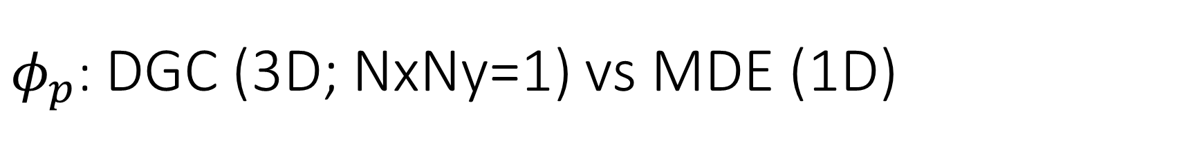
$φ_{p}$: DGC (3D; NxNy=1) vs MDE (1D)
Ns/sigs: dz = 0.10, Ngz_2 = 4$σ$; Chis/bs: dz = 0.25, Ngz_2 = 3.5$σ$

Slide 34


Numericals
Ys
Possibly do Ngz for multiple dzs

Slide 35








3D
Lxy = 1
Lxy = 10
Lxy = 5
Lxy = 15
y-z heatmaps for $φ_{p}$ at constant x

Slide 36





z-FFT vs z-FD (MDE) – REDFT01 xy(z)
Lx = 5, Ly = 5, Lz = 50. s = 0.02. x = 0.75. a = 0.00, N = 50
3D vs 1D (dashed): dz = 0.5, ds = 0.20; dz_1D = 0.113, ds_1D = 0.083
FFT (xyz)
FFT (yz vs pha)
FD (xyz)
FD (yz vs pha)
Diff btw 1D/3D should just be dz, ds, etc.

Slide 37
Specifying Grafted Points

Slide 38
Strategy
2D binary array for surface sites of homogeneously grafted polymer given grafting density, simulation box size, and discretization (and assuming dx = dy)
Fullspace must be periodic on x0 = xL, y0 = yL
Halfspace must be even on xL/2 and yL/2 (overlap of boundary following REDFT00) and periodic on x0 = xL, y0 = yL.
Homogeneous spacing as determined by regular hexagon, where grafting point at centroid of hexagon
In case there are edge effects, try shifting the centroids away from the boundaries of the xy-plane (only did for fullspace)
Make sure no edge effects by comparing results of full FFT with cos FFT

Slide 39
Test conditions
Sigma = 0.05 c/nm2
Lx = 15 nm
Ly = 15 nm
dx = 0.4 nm
Cast in terms of dx (for rounding and PBC for grafting points):
Sigma = 0.0668 c/nm2
Lx = 14.80 nm
Ly = 11.20 nm
(Sigma error decrease with dx)

Slide 40

Padded PBC (Full FFT)
Hexagons drawn for illustration of hexagon approach

Slide 41

Unpadded PBC (Full/Cos FFT)

Slide 42






Other conditions (full and half results overlapped to show match)
s = 0.0241 (20.28%; dx=0.4), Lx, Ly = 12.40, 20.80
s = 0.0208 (4.08%; dx=0.1), Lx, Ly = 12.90, 22.30
s = 0.1332 (11%; dx=0.1), Lx, Ly = 20.50, 20.40

Slide 43


